Slide 1

15º Simpósio Nacional de Informática - Inforum
Integrating Type Operators into the FreeST Programming Language
Paula Lopes
Advisors: Diana Costa, Vasco T. Vasconcelos

Slide 2


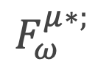
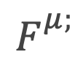
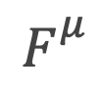

Introduction
$$F_{}^{}$$
$$F_{}^{μ}$$
$$F_{}^{μ;}$$
$$F_{ω}^{μ∗;}$$

Slide 3

Context-free Session Types
Constructors
?T !T ⊕{l: S} &{l: S} End T ; S Skip

Slide 4
Beyond Context-free Session Types
μα: s.&{Leaf: Skip,Node: α; ?Int; α};End?
λβ: t.μα: s.&{Leaf: Skip,Node: α; ?β; α};Wait

Slide 5
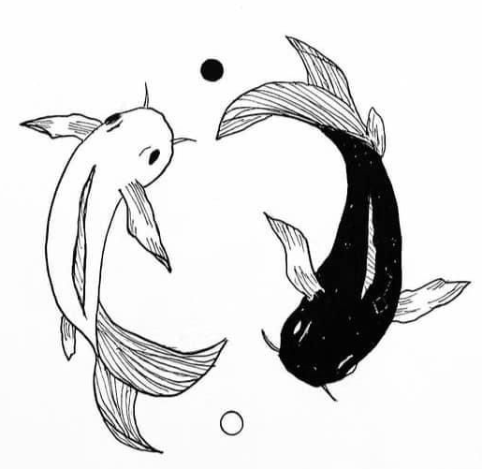
Duality

Slide 6

Kind
Kinds categorize types. A base kind is represented with kind \star, while a higher-order kind is k => k’.
Proper Type
A proper type has a base kind.
Type Operator
A type operator acts upon types to create complex types.

Slide 7
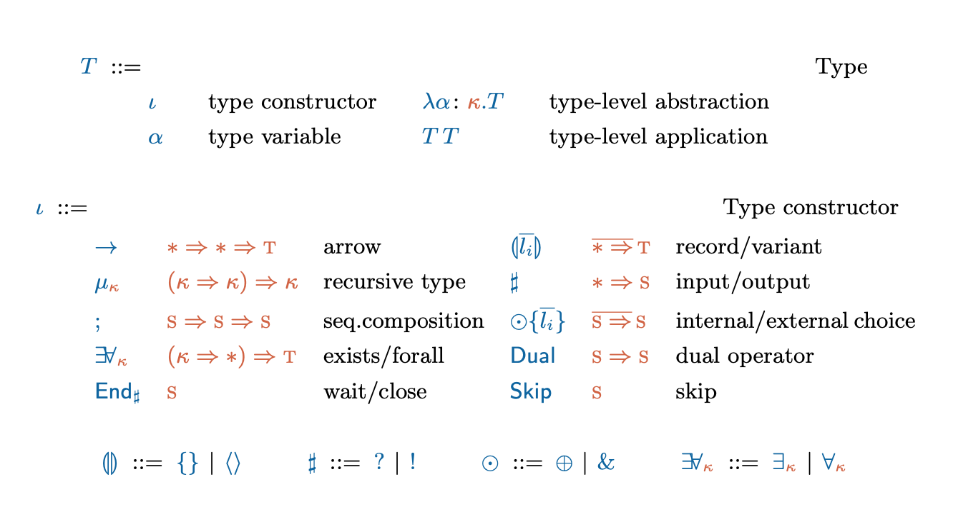

System $F_{ω}^{μ∗;}$
Notes:
Definitions: Kind, proper type, type operator

Slide 8
Dual ( )
!Int
∀s(λα: s.α)

Slide 9
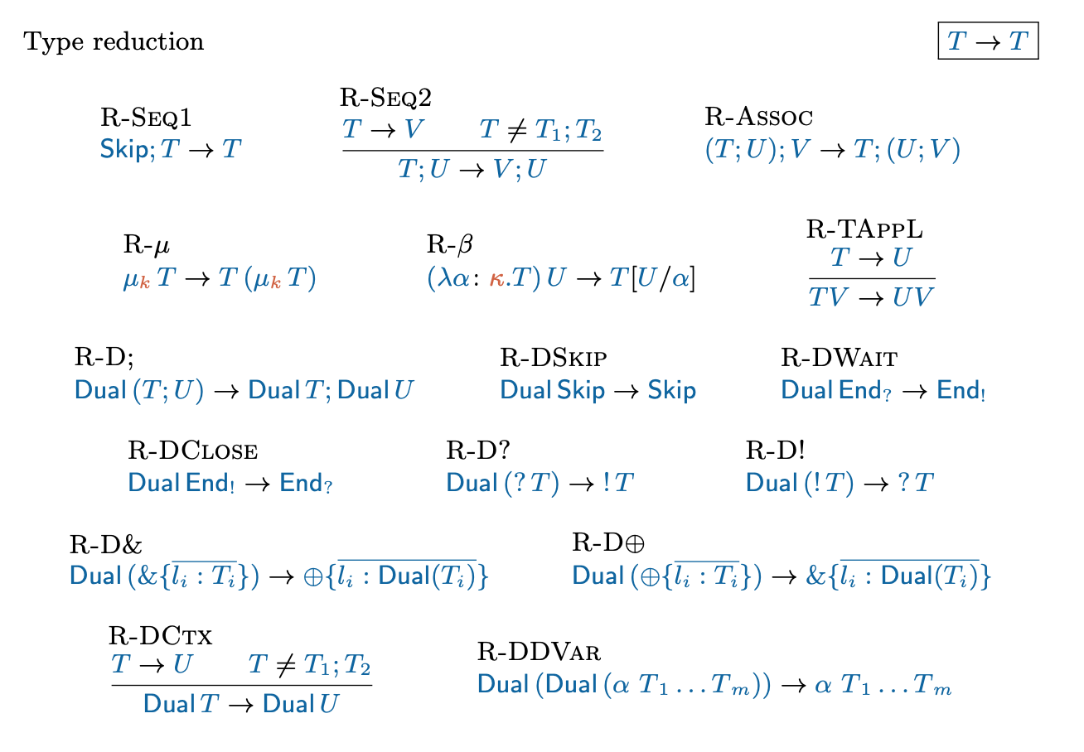
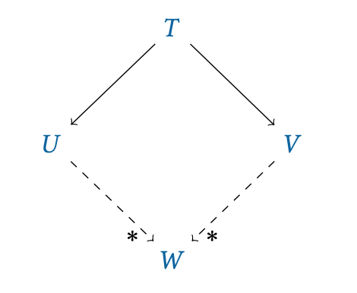
Weak Head Normal Form
Confluence
If there are two distinct reductions for a given type, T-> U and T -> V, then both paths will eventually converge into the final reduced type W.

Slide 10
Normal Form
A type is in normal form if it has been completely reduced.
Norm
A type T normalises to U, if U is in normal form and U is reached from T in a finite number of reduction steps.

Slide 11
T does not normalise
T = (λx.xx)(λx.xx) →
(λx.xx) [(λx.xx)/x] →
(λx.xx)(λx.xx) →
…
Loop of reductions to itself

Slide 12
U does not normalise
U = μs (λα: s.α;Skip) →
(λα: s.α;Skip) U →
U;Skip →
U;Skip;Skip →
· · ·
Trailing Skip.

Slide 13
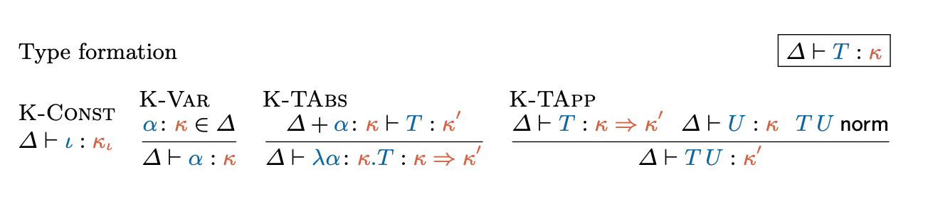
Type Formation

Slide 14
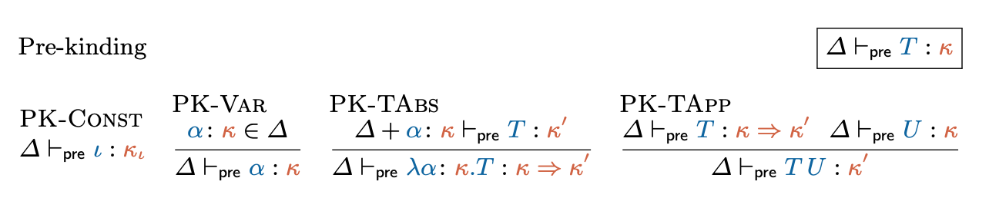
Decidability of Type Formation
Notes:
If T is pre-kinded, T norm terminates.

Slide 15
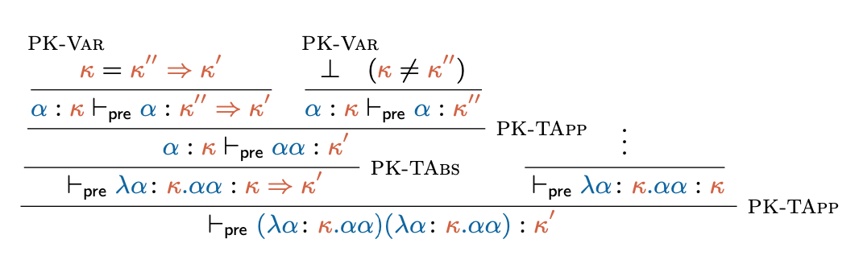

Slide 16
→μ
→β;D
T = T0 ⇓β;D T0′ →μ T1 ⇓β;D T1′ →μ T2 ⇓β;D T2′ →μ · · ·

Slide 17
Check if T is well-formed
First step
Determine if T is pre-kinded, ⊢pre T : κ.
Second step
Determine if T is well-formed, ⊢ T : κ , which involves checking if T normalises.
Notes:
If T is pre-kinded, T norm terminates.

Slide 18
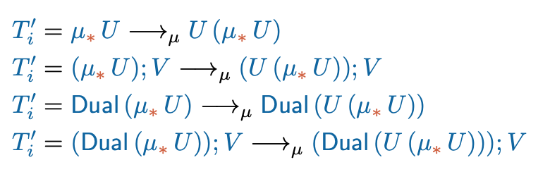

Slide 19
Type equivalence
Type equivalence allows to check whether two types correspond to the same protocol. Two types are equivalent, if their corresponding grammars are bisimilar.
Minimal Renaming
Minimal renaming consists on renaming bound variables in a type by the smallest possible variable available.

Slide 20
Greibach Normal Form Grammar
A grammar is a tuple (T , N , γ, R):
- T is a finite set of terminal symbols;
- N is a finite set of non-terminal symbols;
- γ is the starting word;
- R is a finite set of production rules.

Slide 21


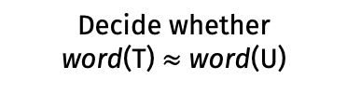
Decidability of Type Equivalence
Algorithm: T ~ U
Compute word(T) and word(U)
Decide whether
word(T) $≈$ word(U)

Slide 22
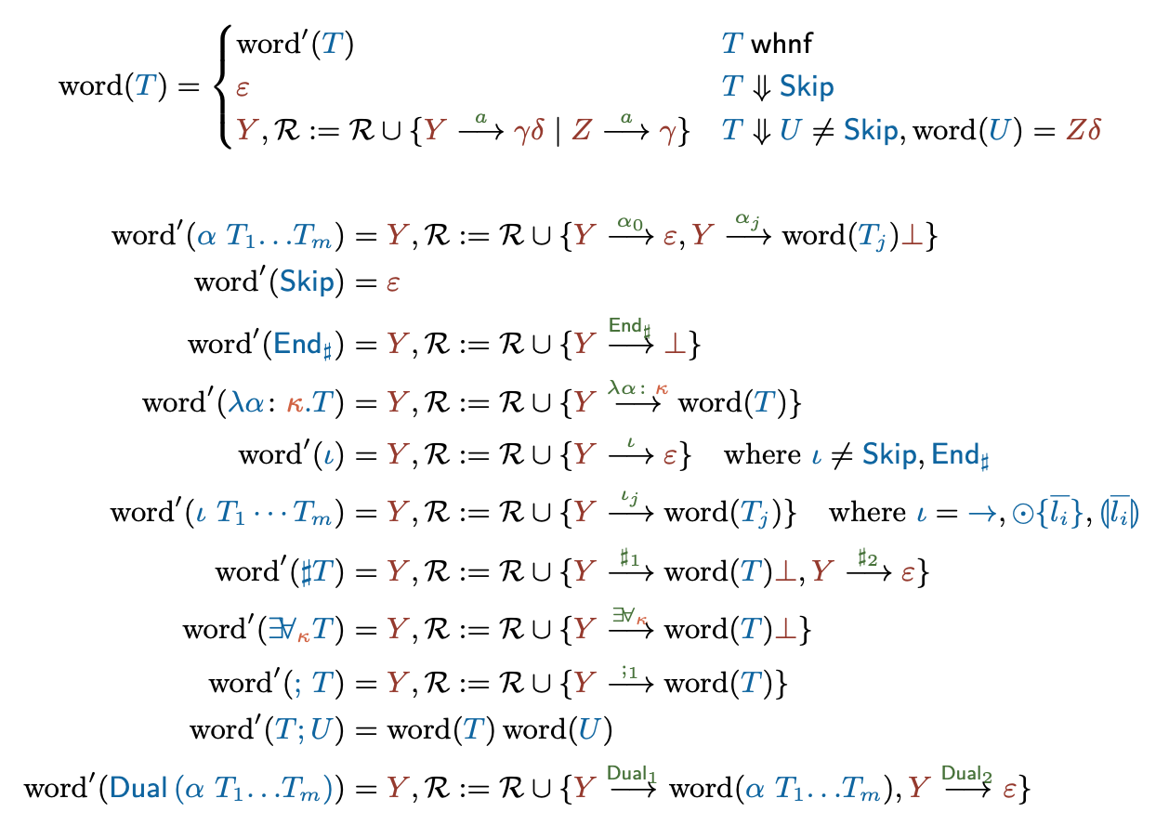
Grammar translation
Notes:
The application of the word function to T terminates producing a simple grammar (because our well-formed types normalise).

Slide 23
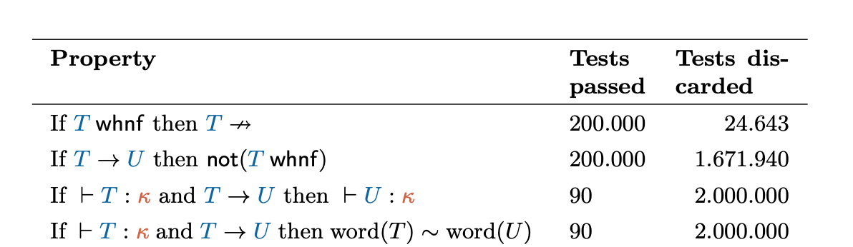
Validation
Notes:
Mention that formal proofs are present in Poças work?

Slide 24
Thank you!
Do you have any questions?

